Slide 1

Recomendation and Online Time Algorithm
Group - x

Slide 2
INTRODUCTION
The codes and algorithms that we are going to view are a book recommendation for the books that user might be interested and an online time mesurement algorithms that both connected to SQL server. We are going to examine the features with the order of point of view of a first time loged in user. First recomendation algorithm, then online time warnings and mesurements.

Slide 3
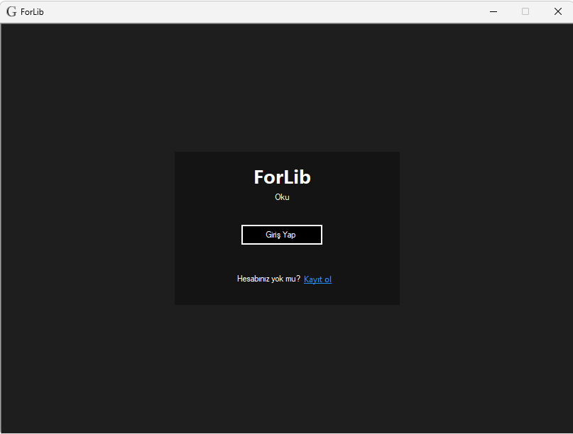
Signing Up for The First Time
When we sign up and login for the first time, our account is saved in the database and starts saving the online time that we spend in the application. Every minute, database gets updated.

Slide 4
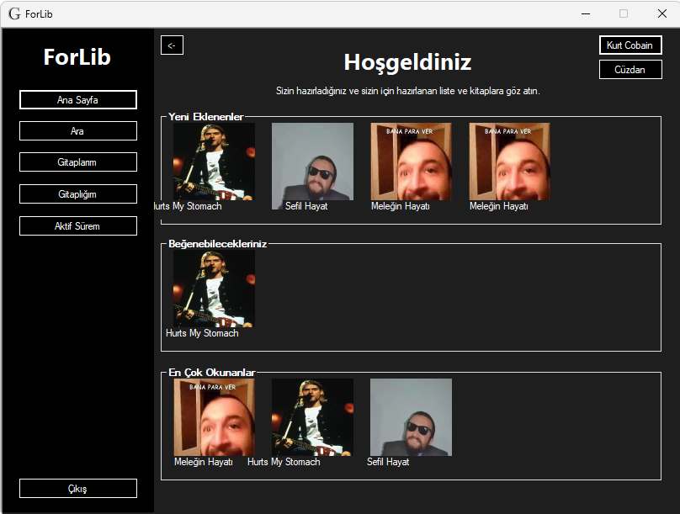
Home Page
In our first login, there wont be a recommended book in the middle section because we don’t have any book tags saved in the SQL database.

Slide 5
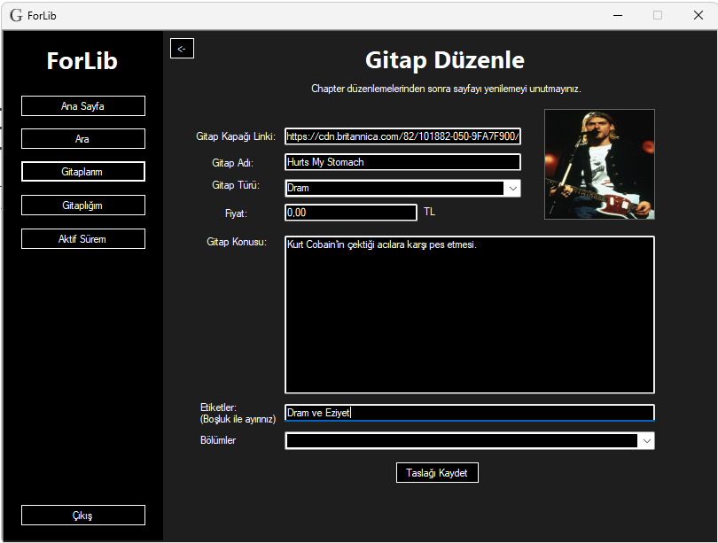
Book Tags
Everybook has tags that saved in SQL server beside other informations. When the user clicks to read the book button, application seperates the single line tags by the space between them and saves them in the database.

Slide 6

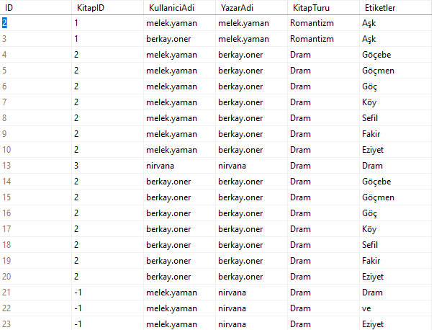
These query results represents the seperation of the tags in different tables in the same database.

Slide 7
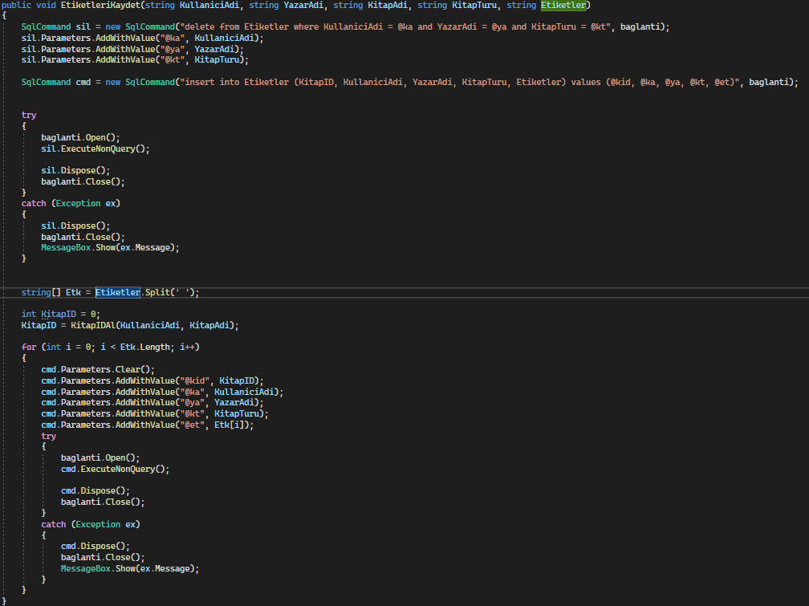
These are the codes
That seperates the tags and saves them again.

Slide 8
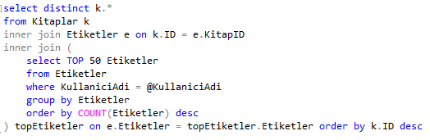
Related Query for Book Recommendation

Slide 9
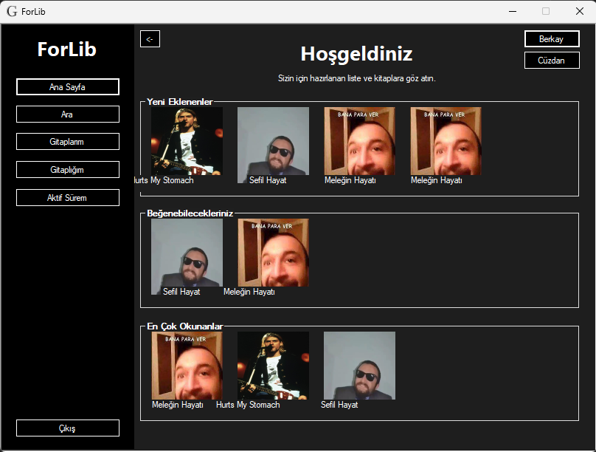
Recommended Books are Done
After getting the query results, there is only listing them on the screen is left. When the user reads a book, algorithm saves and uses only the most recent tags so user can always see the related and new books on his recommended section. This makes the user discover new books and writers to be more active.

Slide 10
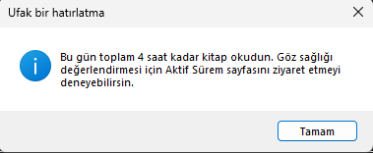
Just A Reminder
When the users meets this reminder, they will probably visit the My Online Time page.

Slide 11
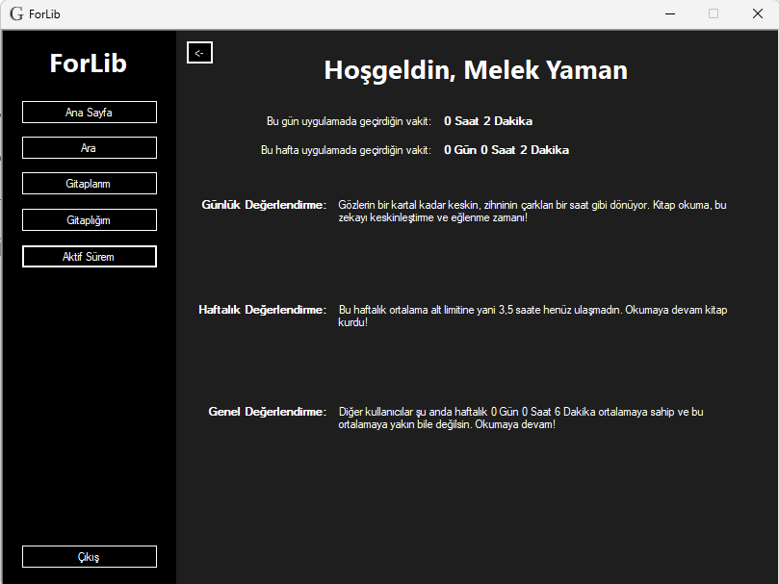
In My Online Time page, user can see his daily and weekly online time count and evaluation of these times. Daily evaluation messages are mostly about the health of the user, weekly is about the sociability and general evaluation is about comparing the user with average weekly time of all the other users. So its about adding more competition to the application and motivating the user.

Slide 12
Thank you for listening

